Slide 1
Signal compression and optimal reconstruction from highly incomplete frequency information using compressive sensing
Title:
(Being carried out at Indian Institute of Science)
External Guide Internal Guide
Dr. Bhakthavathsalam.R Savitha.G
Senior Scientific Officer Associate Professor
Dept of SERC Dept of CS&E
Indian Institute of Science BNMIT
Bangalore Bangalore
Team Members:
Abhishek Sharma.R 1BG10CS003
Chaitra Suresh 1BG10CS025
Chandan S 1BG10CS026

Slide 2
Problem statement
To sample a given analog signal at a rate much lower than the Nyquist rate suggested by the Nyquist-Shannon sampling theorem and reconstruct the original signal from highly incomplete frequency information using the compressive sensing technique, also known as compressed sensing, compressive sampling or sparse sampling.

Slide 3
Introduction
Compressed sensing is a signal processing technique.
Efficient acquisition and reconstruction of a signal is done by finding solutions to underdetermined linear systems.
The entire signal can be determined accurately from relatively few measurements.
Compressed sensing challenges the traditional sample first-then compress procedure.
So what is the basic difference between traditional data sampling and compressive sampling ???

Slide 4
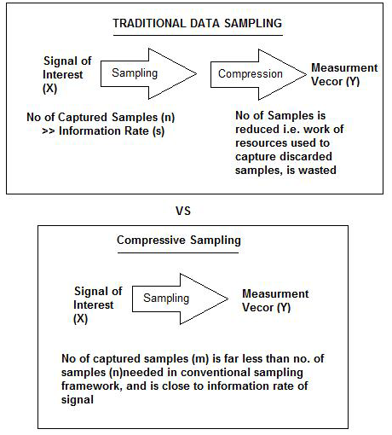

Slide 5
Existing system
The Nyquist-Shannon sampling theorem states that to restore a signal exactly and uniquely, you need to have sampled with at least twice its frequency.
A continuous-time signal with frequencies no higher than f_{max} can be reconstructed from its samples if the samples are taken at a rate f_{s} which is greater than 2 f_{max}.
sampling
Analog
signal
Discrete-time
sequence

Slide 6
Disadvantages of existing system
The signal to be sampled must be perfectly band limited, but no real world signal is truly and perfectly band limited.
We cannot design our system to operate right at the Nyquist rate, at least not with any reasonable chance of success.
In some real world scenarios, collecting large number of samples is not feasible.
The cost of sampling at such a high rate is very high and thus needs to be addressed.

Slide 7
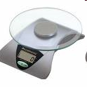


Proposed system
Concept/Analogy
Goal: Identify the bucket with fake coins.
Nyquist:
Weigh a coin from each bucket
Compression
Bucket #
numbers
1 number
Compressed Sensing:
Weigh a linear combination of coins from all buckets
Bucket #
1 number

Slide 8
Stage 1
Signal f=Ψc
Stage 2
Obtain ‘b’ random samples as b=Φf
Stage 3
Reconstruct original signal using l1 magic

Slide 9
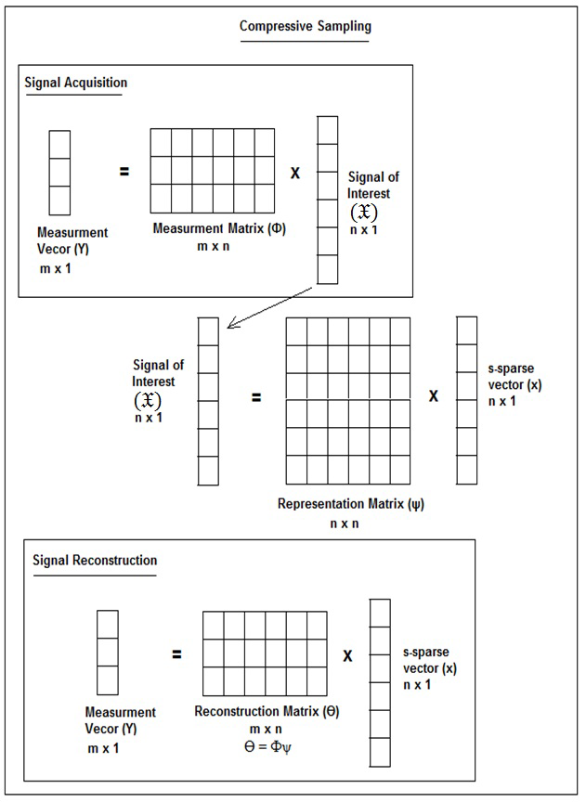

Slide 10
Advantages
Compressed sensing is great for situations where capturing data is expensive (either in energy or time).
The promise to reconstruct signals with limited number of samples that can be below the famous Nyquist limit.
Compressive sensing technique off-loads processing from data acquisition into data reconstruction.

Slide 11
Literature Survey
The basic concepts pertaining to compressive sensing were acquired from the
following papers:
Saad Qaisar, Wafa Iqbal,Rana Muhammad Bilal, Muqaddas Naureen, Sungyoung Lee, "Compressive Sensing: From Theory to Applications, A Survey", Journal of Communications and Networks, October 2013.
D. Donoho, “Compressed sensing,” IEEE Trans. Inform. Theory, April 2006.
The required tool base knowledge was acquired from the following source: http://www.tutorialspoint.com/matlab/index.htm
The following paper may be the basis of the project extension:
D. Akimura, Y. Kawahara, and T. Asami. “Compressed sensing method for human activity sensing using mobile phone accelerometers”. In International Conference on Networked Sensing Systems (INSS), 2012.

Slide 12
Timeline

Slide 13
References
Saad Qaisar, Wafa Iqbal,Rana Muhammad Bilal, Muqaddas Naureen, Sungyoung Lee, "Compressive Sensing: From Theory to Applications, A Survey", Journal of Communications and Networks, October 2013.
D. Donoho, “Compressed sensing,” IEEE Trans. Inform. Theory, April 2006.
D. Akimura, Y. Kawahara, and T. Asami. “Compressed sensing method for human activity sensing using mobile phone accelerometers”. In International Conference on Networked Sensing Systems (INSS), 2012.
E. CandÃ¨s , J. Romberg and T. Tao "Robust uncertainty principles: Exact signal reconstruction from highly incomplete frequency information", IEEE Trans. Inform. Theory, 2006.
An Introduction To Compressive Sampling Candes, E.J. Wakin, M.B. Signal Processing Magazine, IEEE,2008.

Slide 14
Questions??

